Slide 1
College Football Data Modeling Kellen Leland COSC 445: Fundamentals of Digital Archeology

Slide 2

Objective
Collect, clean, and use college football data to build statistical prediction models for NCAA Division 1 FBS games.
Why?
Replace subjective analysis with a more data driven approach to more accurately and consistently pick correctly against the ‘spread’ and ‘over/under’.

Slide 3
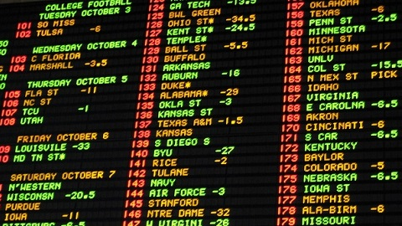
What is a ‘spread’?
What is an ‘over/under’?
Used to even the odds between two unevenly matched teams
Ex: Tennessee -7
Tennessee is favored by 7 points
Must win by a margin greater than 7 points
Can be thought of as a handicap
Ex: Vanderbilt +14
Vanderbilt is the underdog
Must lose by a margin greater than 14 points
Can be thought of as an advantage
Estimated total points in the game
Must pick if there will be ‘over’ or ‘under’ the set total of points
Ex: Total – 58.5
Under wins if there are less than 58.5 total points
Over wins if there are more than 58.5 total points

Slide 4
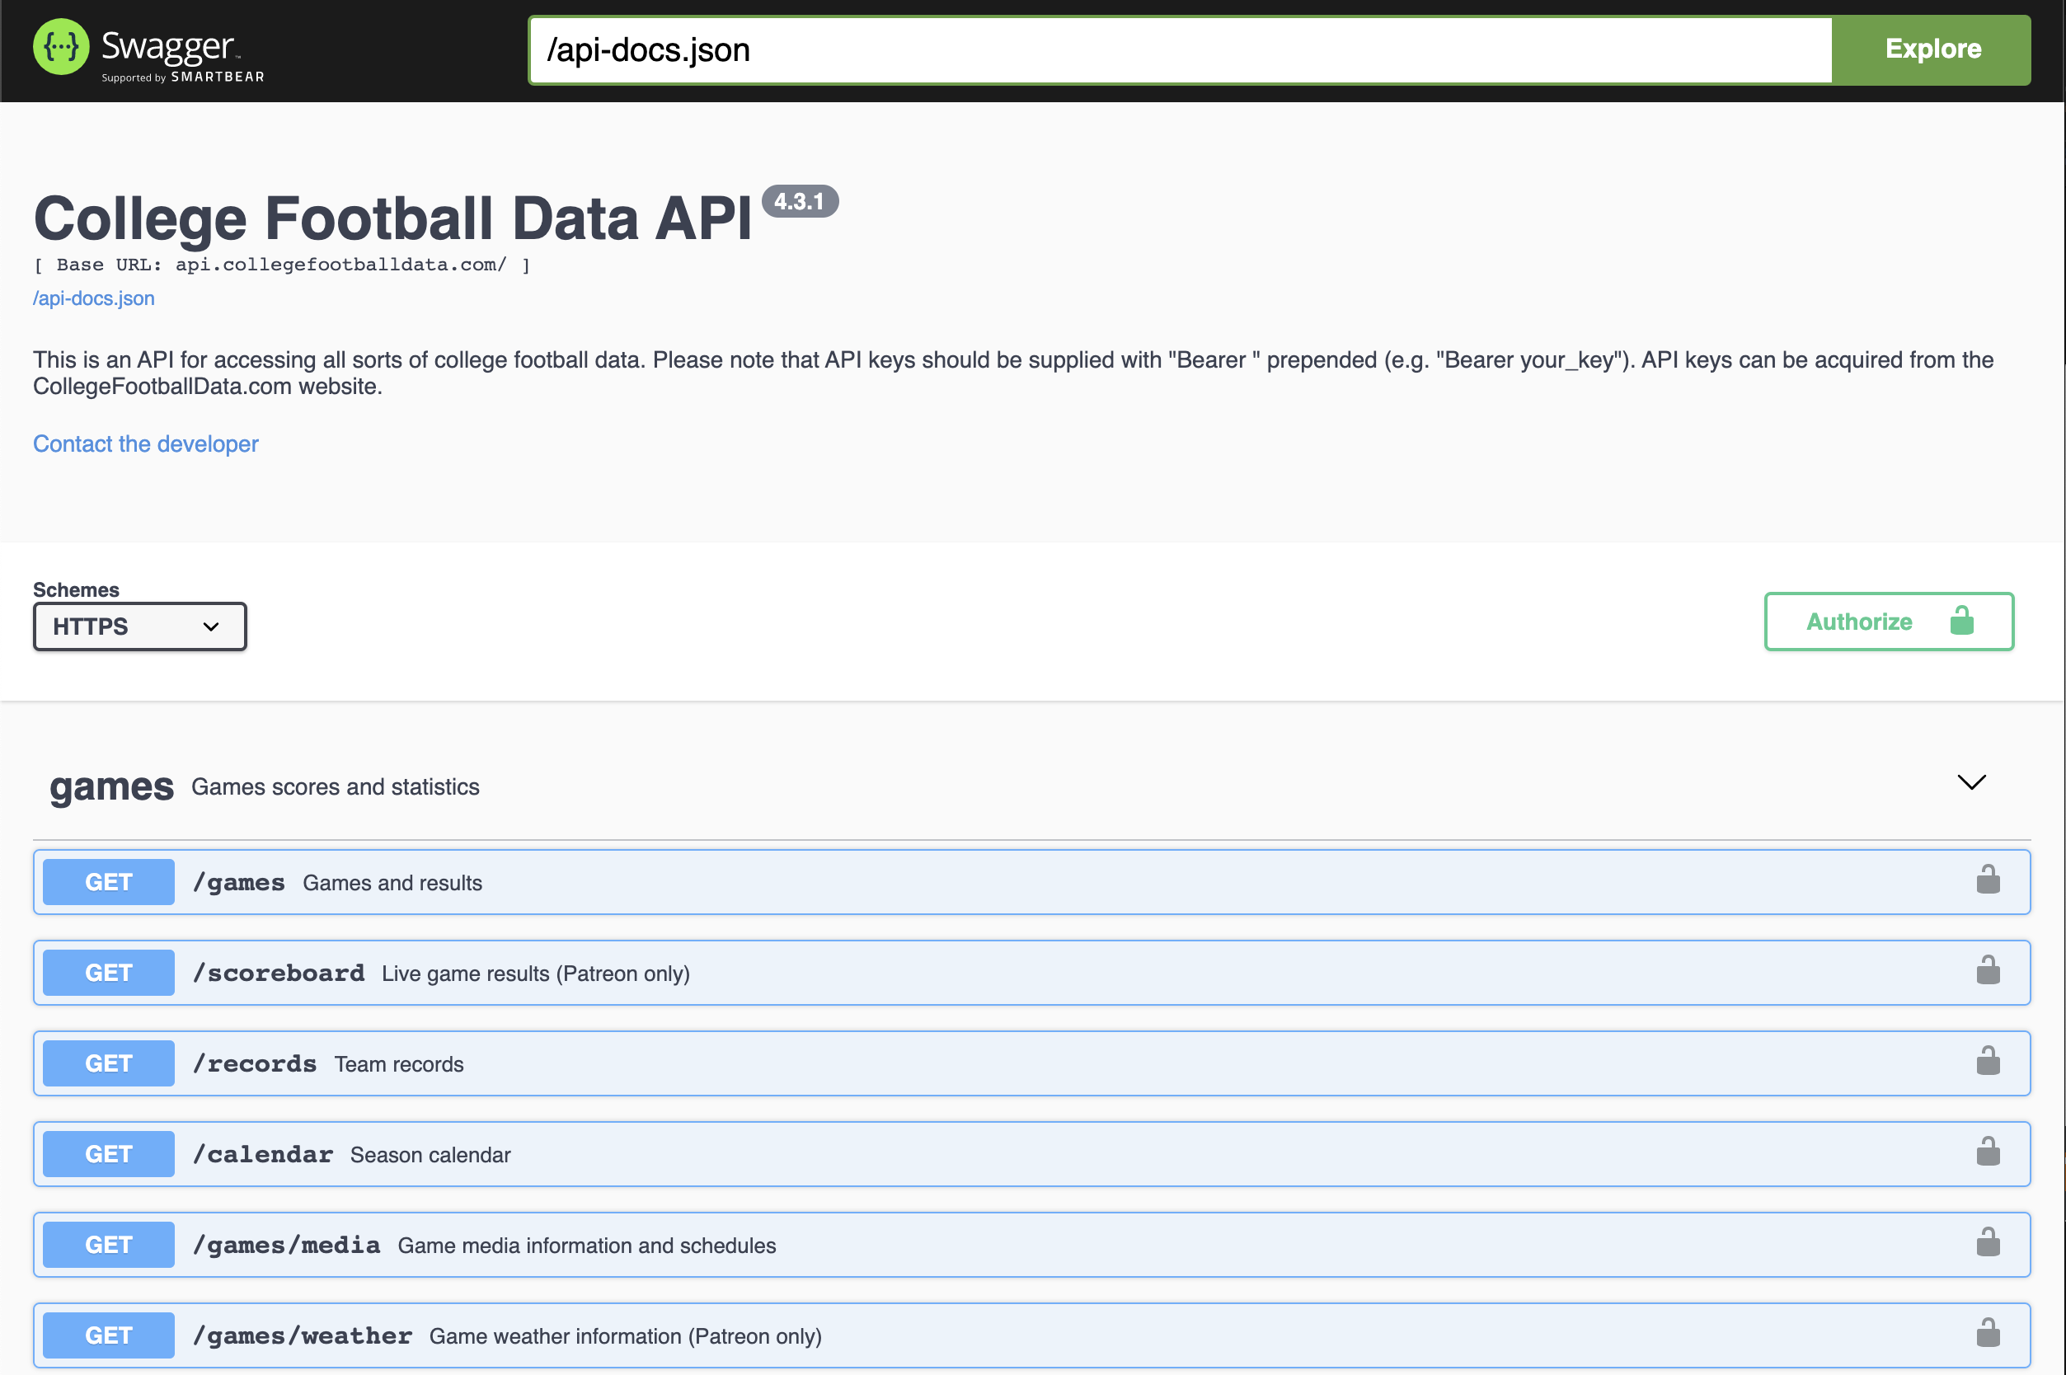
Data Collection
I used a popular college football data API, api.collegefootballdata.com
Free, unlimited API calls
Easy to use web interface
Multiple python wrapper modules available
Wealth of different data points and metrics

Slide 5
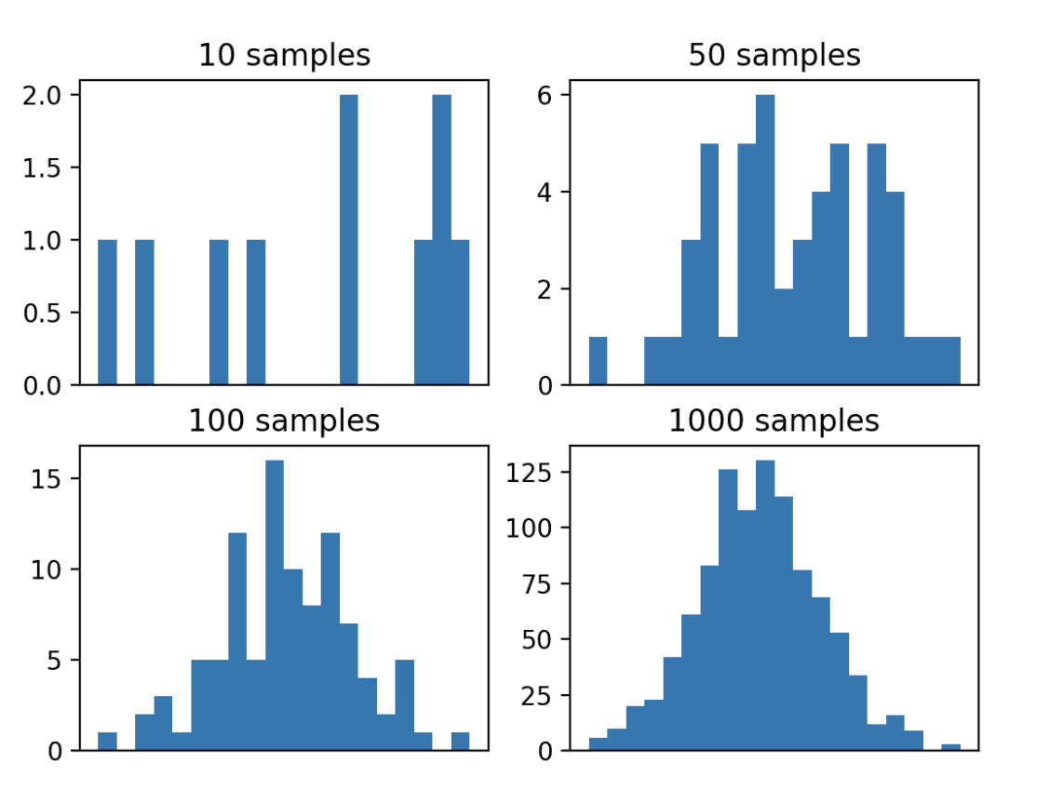
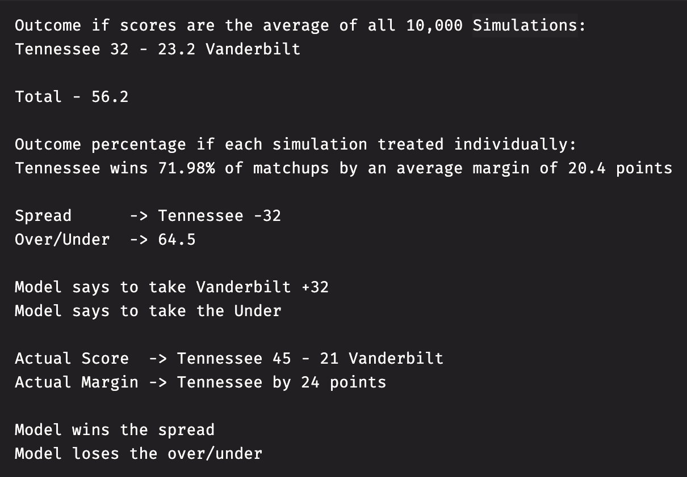
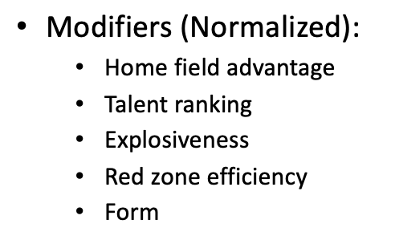
Model 1: Monte Carlo Simulation
Mathematical method for calculating the odds of multiple possible outcomes occurring in an uncertain process through repeated random sampling
Developed by John von Neumann and Stanislaw Ulam during World War II to help leadership make better decisions
Converges on most likely solution in solution space as N becomes very large
Inputs:
Average points scored
Average points allowed
Adjusted points scored
Adjusted points allowed
Standard deviation of points scored
Pseudo-random number [0.0,1.0)
Uses the Inverse Normal Cumulative Distribution Function

Slide 6
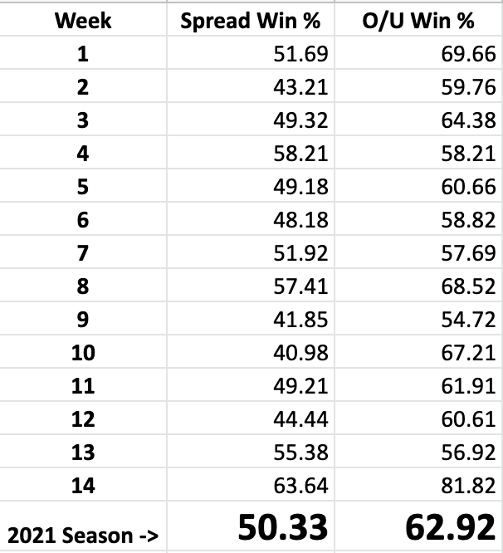

Model 1: Results
Each game simulated 10,000 times
Total points used is the average total of all 10,000 simulations
Spread used is the average margin of victory from the team who won the highest percentage of the simulations
Adding/removing complexity (modifiers) added some variance but did not have a significant impact on the overall results
Most significant modifier was home field advantage
For comparison, below is my record and win percentage through week 14 using strictly subjective analysis

Slide 7
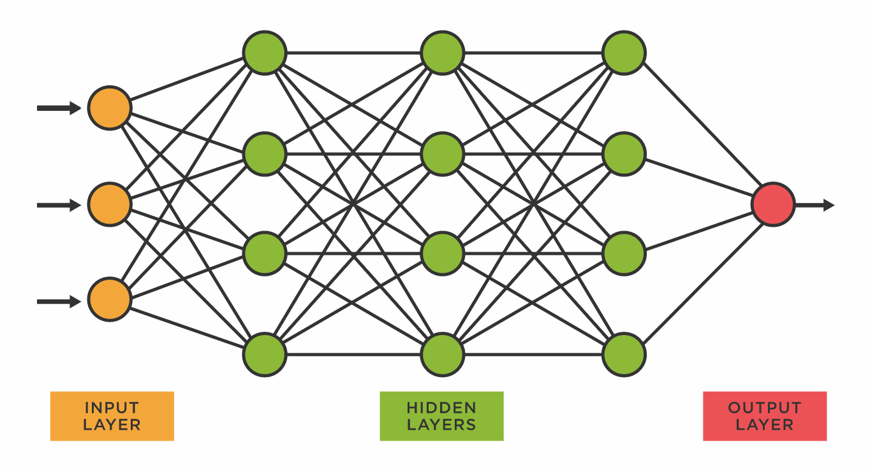
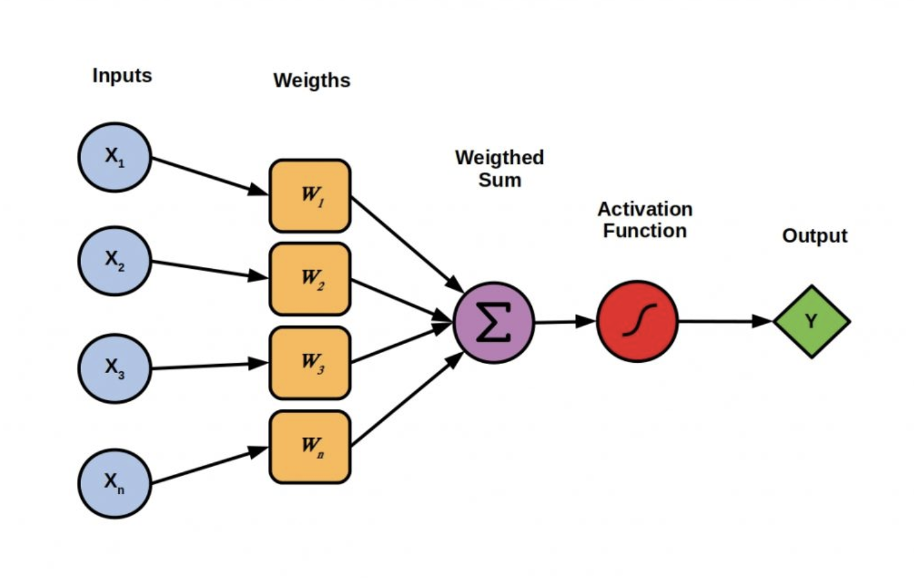
Model 2: Artificial Neural Network
Biologically inspired computational network that can establish empirical relationships between independent and dependent variables
Used the fast.ai Python module which uses PyTorch
Model was trained using data from all FBS college football games from 2015-2020
Features (inputs) used in the training data set was the greatest common subset of data points and metrics collected from all games
Model setup to predict (output) the margin and total points for each game

Slide 8
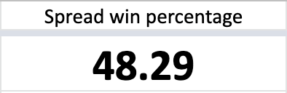
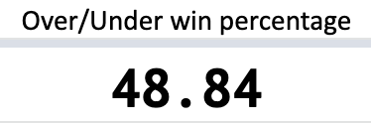
Model 2: Results
Significantly more accurate in predicting the total points than predicting the spread
Not as accurate as Model 1 using the Monte Carlo Simulation
Harder to fine tune due to abstraction, do not know how the artificial neural network is weighting each feature during its analysis
May not be the best approach given the dynamic nature of college football year to year
Still close to matching my subjective analysis win percentage
For comparison, below is my record and win percentage through week 14 using strictly subjective analysis

Slide 9
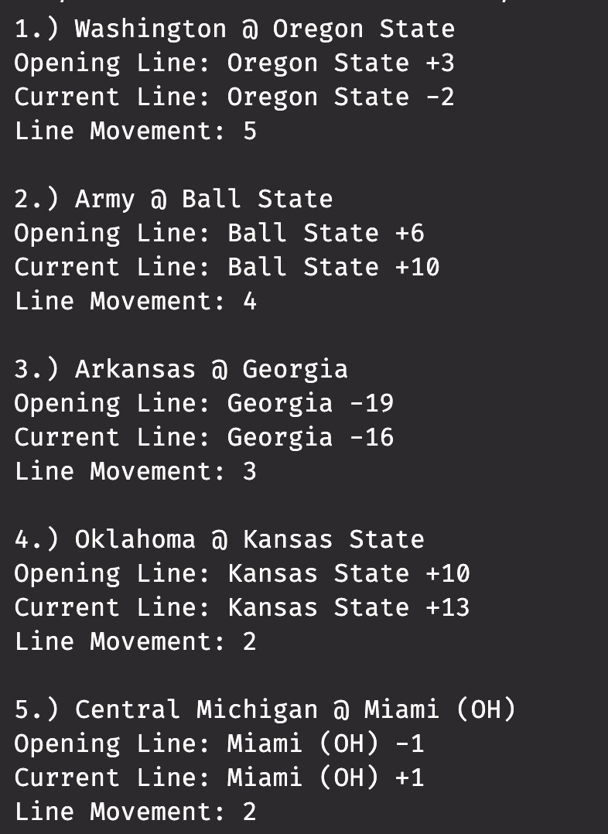
Spread Movement Tool
Spread lines are created and actively adjusted so that either side has an equal amount of ‘action’
This tool shows the games with the greatest amount of movement in the line
Lots of line movement means there are a large number of bettors moving the line up or down
Tool can be used to gain insight on what the general public thinks is going to happen in a game
Extremely useful in situations where the user has access to a ‘locked line’ and can exploit the line movement
Can be used in conjunction with other models to help find games with the most value

Slide 10
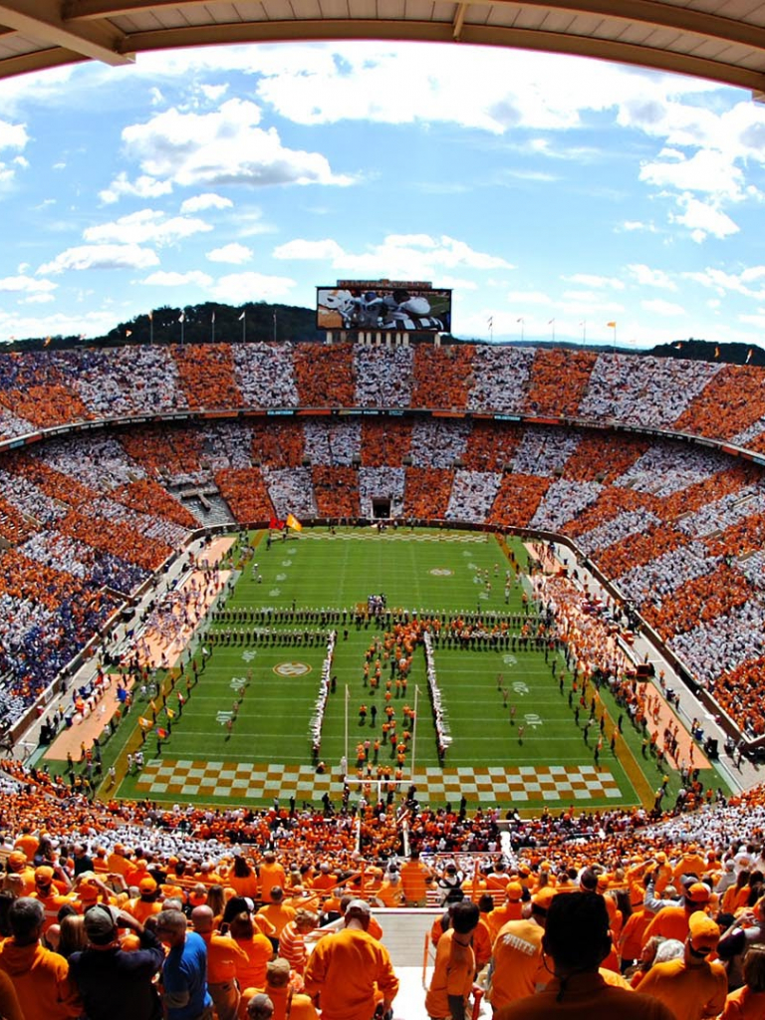
Conclusion
Prediction modeling requires fine tuning of input parameters for the best results (more != better)
Generally easier to predict the total points than the winner against the spread
Best method seems to be a multifaceted approach using multiple models/tools to find outlier games (those with largest difference in spread/total and predicted value) that can be exploited
Future Work
Add functionality to line movement tool for the over/under
Fine tune inputs/modifiers for Monte Carlo Simulation
Try training ANN model with different training data (maybe only more recent data due to dynamic nature of college football)
Add ability to web scrape websites with custom and specialty metrics
Create model output comparison tool that highlights outlier games

Slide 11

Questions?

